Slide 1

Earthquake Prediction model Using python -AI

Slide 2

Introduction
AI & ADS:
In these two technology projects you will begin building your project by loading and preprocessing
the dataset. Perform different analysis as needed. After performing the relevant activities create a
document around it and share the same for assessment.
DAC:
In this technology projects you will begin building your project by loading and preprocessing the
dataset. Perform different analysis and visualization using IBM Cognos. After performing the
relevant activities create a document around it and share the same for assessment.
IOT:
In this technology project you will begin building your project by deploying IoT devices and then
developing a Python script on the IoT devices as per the project requirement. After performing the
relevant activities create a document around it and share the same for assessment.
CAD:
In this technology projects you will begin building your project using IBM Cloud Foundry. Perform
different functions as per project requirement. After performing the relevant activities create a
document around it and share the same for assessment.

Slide 3

AI&ADS Data Collection: Gather historical earthquake data, including features like location, magnitude, depth, and time. You can obtain this data from sources like USGS (United States Geological Survey). Data Preprocessing: Clean and preprocess the data. This includes handling missing values, normalizing numerical features, and encoding categorical data. Feature Engineering: Extract relevant features and perform feature selection to improve model accuracy. Machine Learning Model Selection: Choose a suitable AI model for earthquake prediction. Common choices include Random Forest, Support Vector Machines, and neural networks. Model Training: Split the data into training and testing sets, and train your chosen model on the training data.

Slide 4
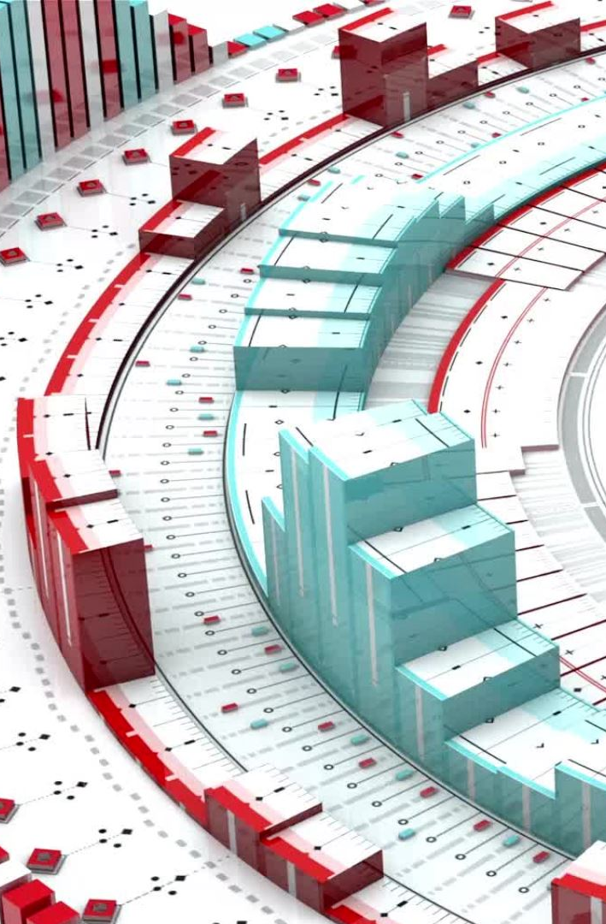
DAC
Data Collection: You'll need access to a substantial amount of seismic data, which is typically provided by organizations like the USGS. This data will include information on past earthquakes, such as their magnitudes, locations, and depths.
Feature Engineering: Extract relevant features from the seismic data. These might include historical seismic activity, fault lines, geological data, and more. You'll also need to consider other environmental factors like weather conditions and tides.
Data Preprocessing: Clean and preprocess the data, dealing with missing values and outliers. Normalize or standardize the data as necessary.
Model Selection: Choose an appropriate machine learning or AI model. Time series forecasting techniques, neural networks, and regression models are commonly used. Deep learning models, such as LSTM (Long Short-Term Memory) networks, can capture temporal dependencies.
Model Training: Train your model using historical earthquake data. Split your data into training, validation, and test sets to evaluate the model's performance.

Slide 5

IOT
Data Collection:
Collect historical earthquake data from reliable sources such as USGS.
Set up IoT devices to monitor seismic activity, temperature, humidity, and other relevant parameters in real-time.
Data Preprocessing:
Clean and preprocess the collected data.
Combine IoT sensor data with historical earthquake data.
Feature Engineering:
Extract relevant features from the data, such as seismic sensor readings, geographic coordinates, and time.
Model Selection:
Choose a suitable AI model for earthquake prediction. This could be a deep learning model like a recurrent neural network (RNN) or a convolutional neural network (CNN).
Model Training:
Train the selected model using the preprocessed data.
Real-time Monitoring:
Continuously feed real-time IoT sensor data into the model.

Slide 6

CAD Data Collection: Gather earthquake data, including historical seismic activity, fault lines, and geological data. You can use sources like the USGS Earthquake Catalog Data Preprocessing: Clean and preprocess the data. This involves handling missing values, scaling data, and converting it into a suitable format for machine learning Feature Engineering: Extract relevant features from the data, such as seismic magnitude, location, depth, and historical earthquake patterns. Model Selection: Choose an AI model suitable for time-series data. Recurrent Neural Networks (RNNs) and Long Short-Term Memory (LSTM) networks are commonly used for time series prediction Model Training: Train the selected model on your preprocessed data. You might use libraries like TensorFlow or PyTorch for this.

